Slide 1
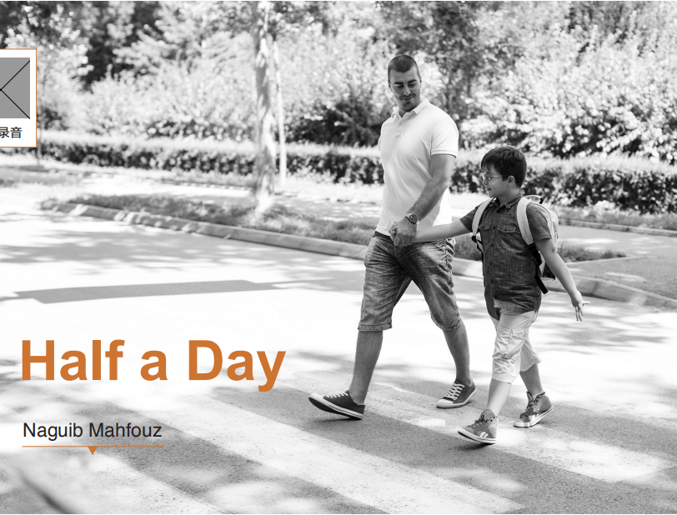
Unit 1
1. Lead-in
2. Text analysis
3. Glossary
4. Exercise
5. Extension

Slide 2



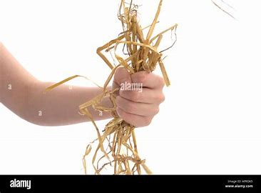
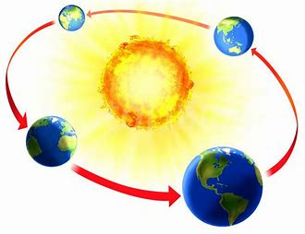
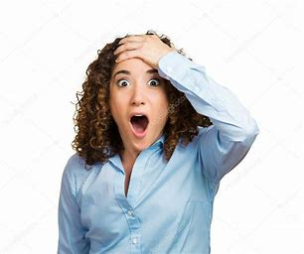
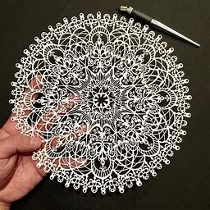
Glossary
clutch intricate irritated perseverance revolve rivalry spin startled
spin
revolve
perseverance
clutch
irritated
startled
intricate
rivalry

Slide 3
Translation
Chinese to English translation.
1) 她坚持相信他是清白的。(cling to)
2) 自从听到那个消息，我一直茫然不知所措。(daze)
3) 如果不是那么绝望的话我是不会诉诸法庭的。(resort)
English to Chinese translation.
1) She had the tightest clutch on a pound.
2) Once you make your decision, don't be overtaken by misgivings and fear.
3) A double room with a balcony overlooking the sea had been reserved for him.
4) Through great exertion, the team managed to meet the deadline.

Slide 4

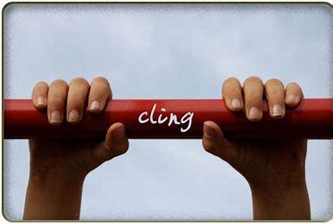
Glossary
cling vi. (clung, clung)
1. hold onto sth. or sb. tightly with your hands or arms, for example because you are afraid （因害怕等）抓住，抱紧
The girl clung to her boyfriend's arm when a dog was coming near.
一条狗走近时，那个女孩挽紧了她男朋友的手臂。
2. (~ to) stick to or fit very tightly on sth. 黏着；紧贴；坚持
1) 她坚持相信他是清白的。
She clung to the belief that he was innocent.
2) I do not cling to my children. In fact, I‘m pretty free-range.
我不粘着我的孩子。其实上，我对孩子还是很放手散养的

Slide 5

Glossary
clutch
1. v. (at) hold sb. or sth. firmly, for example because you are afraid or in pain, or do not want to lose them 紧抓；紧握
The mother clutched her baby in her arms.
母亲紧紧地把婴儿抱在怀里。
2. n. 1) 握住；紧抓 2) 掌握，控制 3）离合器
  She had the tightest clutch on a pound.
  她是一个嗜钱如命的家伙。
  Tony fell into the clutches of the police.
托尼落入了警察的手掌之中。

Slide 6


Glossary
daze n. [sing.] a state of stunned confusion or bewilderment 眩晕；迷茫
in a daze: in a state of being unable to think clearly 处于茫然状态
1) 自从听到那个消息，我一直茫然不知所措。
I've been in a complete daze since hearing the news.
2) 我茫然地走了一个小时。
For an hour I was walking around in a daze.

Slide 7

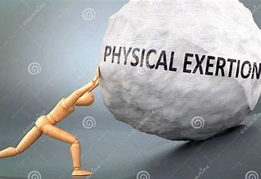
Glossary
exertion n. [C, U] great physical or mental effort 费力；努力；尽力
1) Solving the complex mathematical problem required tremendous mental exertion.
解决那个复杂的数学问题需要巨大的脑力消耗。
2) Through great exertion, the team managed to meet the deadline.
通过巨大的努力，团队设法在最后期限前完成了任务。
exert v. 1) use your power, influence etc. in order to make sth. happen 运用（权力）；施加（影响力）2) ~ oneself 努力；竭力
His books exerted immense influence on the youth.
他的书对年轻人产生了巨大的影响。
In order to be successful he would have to exert himself.
他必须努力才能成功。

Slide 8

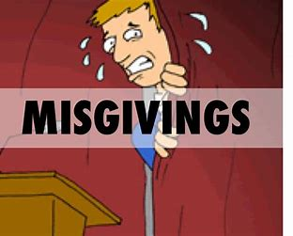
Glossary
misgiving n. [usu pl.] feelings of doubt and fear 疑虑；顾虑；担忧
1) He looked with misgiving at the strange food on his plate..
他用疑虑的眼光看看他碟子上奇怪的食物。
2) Once you make your decision, don't be overtaken by misgivings and fear.
一旦做了决定，就不要瞻前顾后，畏首畏尾。

Slide 9

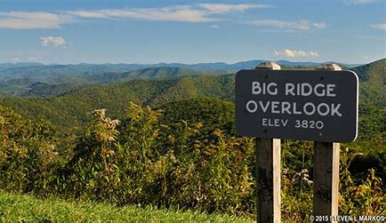
Glossary
overlook v.
1. have a view of sth. from above 俯视；眺望
A double room with a balcony overlooking the sea had been reserved for him.
一个带阳台的海景双人间已预留给他了。
2. fail to notice sth. 忽视；忽略；
The parents should not overlook their own roles in shaping children's minds.
父母不应该忽视他们自己对塑造孩子心智方面的影响。

Slide 10

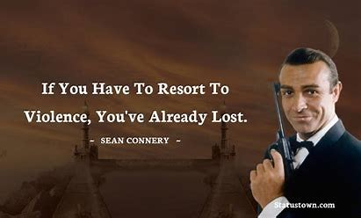
Glossary
resort
1. v. do or use sth. esp. because no other choices are possible 采取，诉诸
1) If other means fail, we shall resort to force.
如果其他手段均告失败，我们就将诉诸武力。
2) 如果不是那么绝望的话我是不会诉诸法庭的。
I would never have resorted to a court of law if I hadn’t been so desperate.
2. n. [C] a place many people go to for a holiday 度假地；游览胜地
summer resort.
避暑胜地。

Slide 11

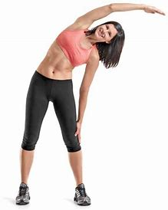
Glossary
stretch
1. I leaned back in the chair and stretched with a yawn.
2. Make sure that the rope is stretched tight.
3. Fields and hills stretched out as far as we could see.
4. I need a job that will stretch me.
5. It's a very dangerous stretch of road.
1. 伸懒腰
2. 拉直，绷紧
3. 延伸；绵延
4. 使竭尽所能；使发挥出全部本领
5. n. 一段

Slide 12
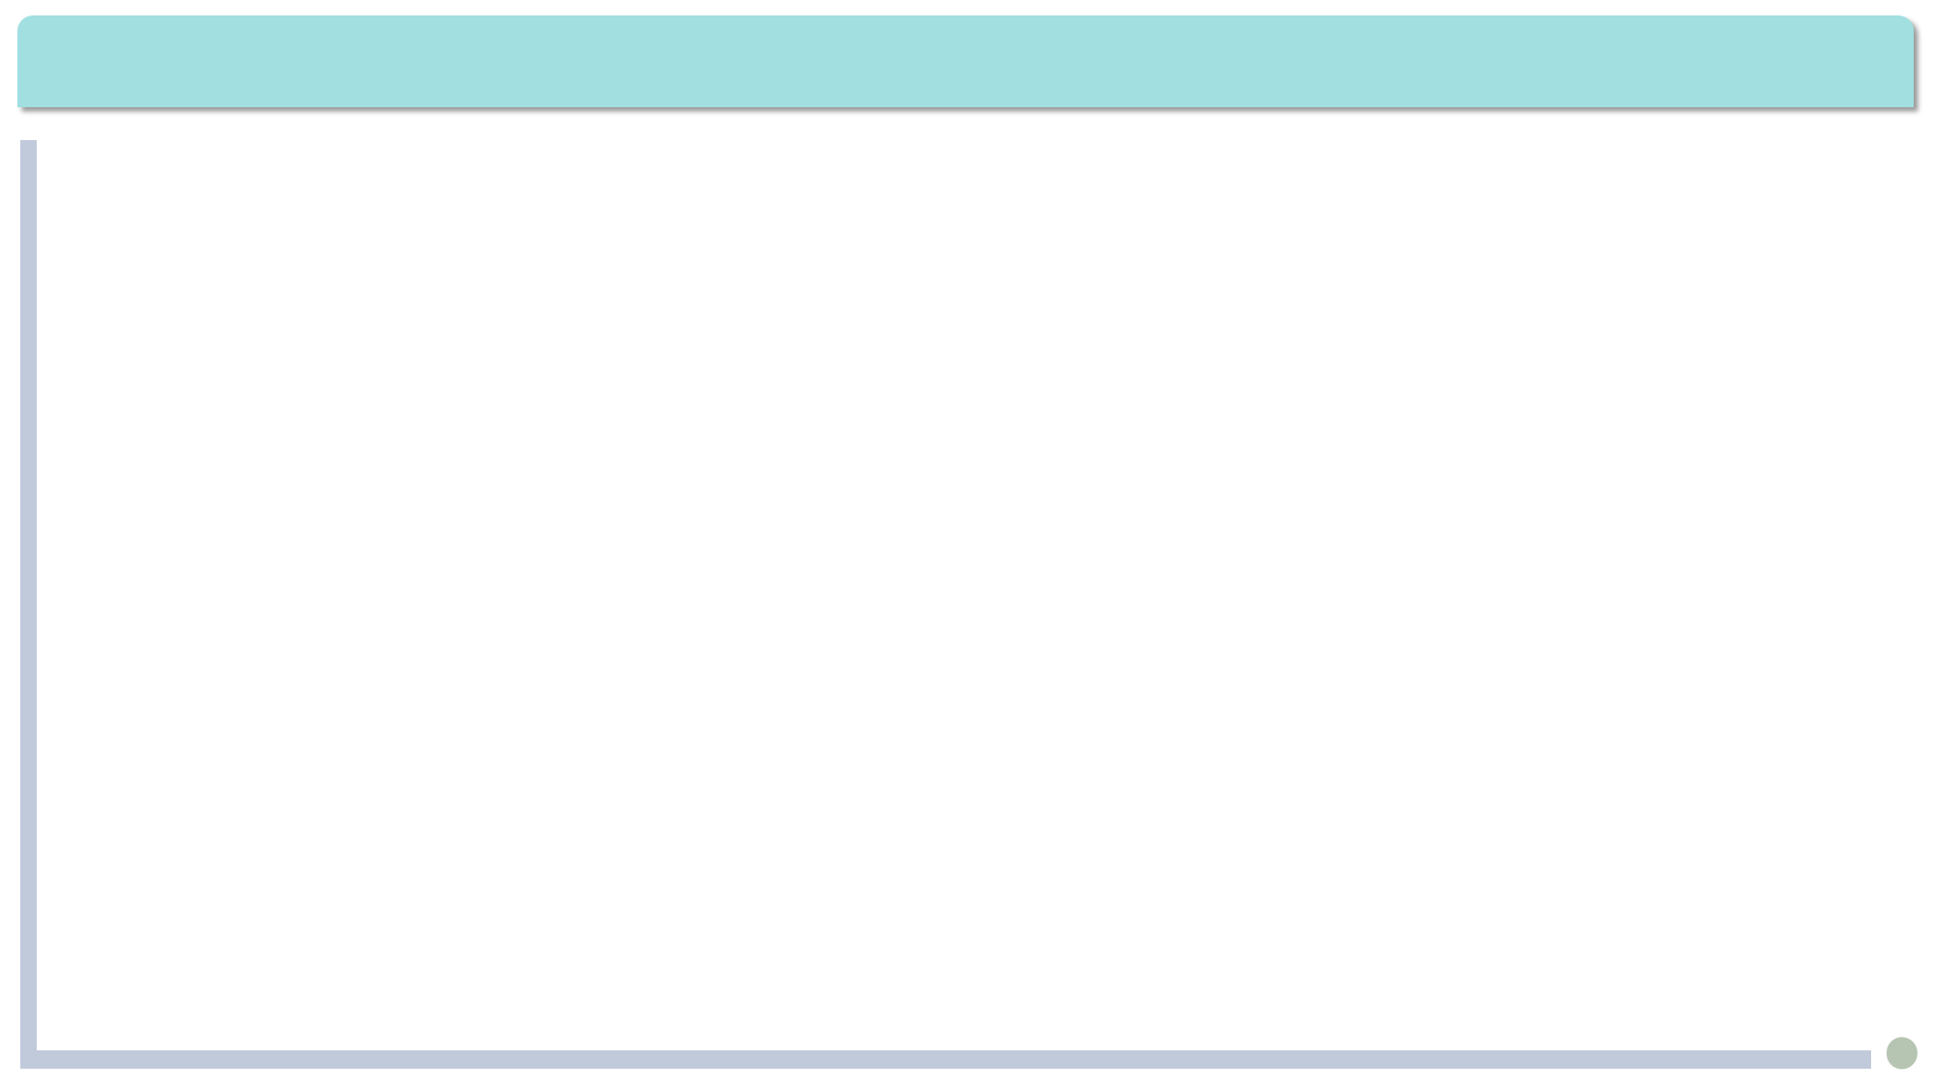
Exercises · Language Exercises
5. Complete the sentences with different forms of the word given.
differ
1) Opinions still ________ among economists as to whether the economy will soon recover.
2) People often think _________ because they have __________ positions.
3) I can’t tell the _________ between the two. They seem the same to me.
serious
4) The situation is getting very _______. But the most _______ thing is that not many people take it ________.
5) I know the __________ of the matter. Today our rivers and lakes are _________ polluted, and so are our land and air.
differ
differently
different
difference
serious
serious
seriously
seriousness
seriously

Slide 13
Exercises · Language Exercises
5. Complete the sentences with different forms of the word given.
attention
6) We must pay close __________ to it.
7) The students all listened to the teacher very __________ . But to be ________ is not enough. There should be more interaction between the students and the teacher.
attention
attentively
attentive

Slide 14
Exercises · Language Exercises
2. Complete the following verb + noun collocations according to the Chinese in the brackets.
1) __________ a few steps (走几步)
2) __________ one’s way (迷路)
3) __________ one’s tears (擦干眼泪)
4) __________ a nap (小睡片刻)
5) __________ life (面对生活)
6) __________ the street (穿过街道)
7) __________ one’s mind (改变主意)
8) __________ a place (涌入某地)
walk/take
lose
dry
take
face
cross
change
invade

Slide 15
Exercises · Language Exercises
3. Fill in the blanks with the correct form of the phrases listed below.
in vain show off resort to cling to bring about
burst into on one’s own take advantage of find one’s way be lined with
1. Unlike high school students who have many classes to go to, university students should spend most of their time studying ___________.
2. Peter loves to __________ his new fancy car, for it is just about the only property he has.
3. When the speaker stepped onto the platform, the audience __________ a thunderous applause.
4. Clearly, it was the town’s poverty that had ____________ its high crime rate.
5. Both sides are willing to sit down and talk because they know it is stupid to __________ force.
on their own
show off
burst into
brought about
resort to

Slide 16
Exercises · Language Exercises
3. Fill in the blanks with the correct form of the phrases listed below.
in vain show off resort to cling to bring about
burst into on one’s own take advantage of find one’s way be lined with
6. He was caught in the rain and returned home, wet all over and trembling with his clothes __________ his body.
7. When he was in England, he ________________ every opportunity to improve his spoken English.
8. He tried to make his father change his mind, but it was all __________ because his stubborn father was determined to make him a great musician.
9. Nobody knew how these strange animal bones _______________ into this cave.
10. This is a well-known tourist attraction. The street ____________ about a dozen 18th-century houses that survived World War II destruction.
clinging to
took advantage of
in vain
found their way
is lined with

Slide 17
Exercises · Language Exercises
4. Fill in the blanks with the correct prepositions or adverbs that collocate with the verbs “make” and “show”.
1. Houses in that part of the country were mostly made _____ cheap material. They all collapsed in the earthquake.
2. The wine is made ________ the best grapes in our country.
3. In the distance, we saw the ship making _____(前往) the shore.
4. Mr. Shaw’s views are changing all the time. Nobody can make ____ (理解)what he really means.
5. John said that he had made ____ his mind to study Information Technology).
of
from
for
out
up

Slide 18
Exercises · Language Exercises
4. Fill in the blanks with the correct prepositions or adverbs that collocate with the verbs “make” and “show”.
6. It was not long before people found out that the story was made ____ by the man. In truth, he had never seen a tiger on that mountain.
7. Mary worked harder than before; she knew she had to make ______ (弥补)the time she had lost.
8. Mr. Brand soon made friends ____ the young people in his office.
9. It is important to make use ____ our rivers’ water power, but dams can create environmental problems.
10. People made fun ____ him because he really made a fool _____ himself(出洋相).
up
up for
with
of
of
of

Slide 19
Exercises · Language Exercises
4. Fill in the blanks with the correct prepositions or adverbs that collocate with the verbs “make” and “show”.
11. They had a big argument the other day and did not speak to each other for several days, but now they have already made ____ (言归于好).
12. Show Mr. Freeman ____ when he arrives. I need to talk to him immediately.
13. That party is being thrown in your honor; so, naturally people expect you to show ____ .
14. When you settle down, I’ll show you ______ (带领……参观)and introduce you to the department managers.
up
in
up
around

Slide 20
Exercises · Language Exercises
5. Fill in the blanks with the correct form of the appropriate words or phrases in the brackets. Note that more than one of them may be appropriate.
1. We came to a __________ (high; tall) building with a ______ (huge; vast) gate.
2. In this _____ (big; huge; vast) land, there is not a single ______ (high; tall) mountain.
3. Our oral English teacher is a ____ (high; tall) young woman with ____ (big; large; huge; vast; great) bright eyes.
4. As college students _______ (each; every) one of us must pay attention to current _______ (matter; affair).
5. Social stability has become an extremely serious _______ (matter; affair) in many ______________________ (country; nation; state). They will be in ______________ (large; big; huge; great; vast) trouble if they don’t take immediate action.
high / tall
huge
vast
high
tall
big
every
affairs
matter
countries/nations/states
big/huge/great

Slide 21
Exercises · Language Exercises
5. Fill in the blanks with the correct form of the appropriate words or phrases in the brackets. Note that more than one of them may be appropriate.
6. In a(n) ______ (affair; matter) of decades, the members of the United _______ (state; nation) jumped to almost two hundred.
7. With the reform policy, business enterprises were no longer owned by the ______ (country; nation; state) only, and prices also were no longer controlled by the ________ (country; nation; state).
8. In _____ (few; a few) months, we all made ______________ (big; large; huge; vast; great) progress in our studies. Everybody was in _____ (high; tall) spirits.
9. People today know ______ (little; a little) about that history because it happened long ago, and ______ (few; a few) books have been written on it. I know _______ (little; a little) because my father is a historian. He has told me ______ (few; a few) things.
matter
Nations
state
state
a few
big/huge/great
high
little
few
a little
a few

Slide 22
Exercises · Language Exercises
6. Study the following examples and complete the sentences by translating the Chinese in the brackets, paying attention to the object complements in the sentences.
1. He found _____________ (门锁上了) from the outside, and this made him _________ (很生气).
2. When Sima Yi saw _____________________ (城门大开) and Zhuge Liang _______________ (弹琴) on the city wall, he found ____________ (这十分奇怪).
3. I think it _________________ (很清楚) that he’d like to make his son ____________ (他的接班人).
4. You really made me ______________ (担心). I heard you _______________ (自言自语) loudly in your dream last night.
the door locked
very angry
the city gate wide open
playing the guqin
it very strange
quite obvious/clear
his successor
worried/anxious
talking to yourself

Slide 23
Exercises · Language Exercises
6. Study the following examples and complete the sentences by translating the Chinese in the brackets, paying attention to the object complements in the sentences.
5. I have never seen some of our rivers and lakes ________________ (污染得如此严重). Sooner or later, it will make us _____________ (付出代价) for what we have done to our environment.
6. I could feel _________________________________ (大地在颤抖) and I could see huge rocks ____________ (滚下来) from the top of the mountain.
7. She found a young wounded soldier ______________ (躺在草地里), ________________(身上全是血).
so heavily polluted
pay (the price)
the ground shaking/trembling/quaking
rolling down
lying in the grass
covered with blood

Slide 24
Exercises · Language Exercises
6. Study the following examples and complete the sentences by translating the Chinese in the brackets, paying attention to the object complements in the sentences.
8. I have been trying to get my father _____________________________ (对种花养草或者画画产生兴趣), something to _________________ (能使他有事干).
9. Did you ___________ (听她说) yesterday that she wanted to have the meeting ________________ (延期)?
interested in gardening or painting
keep him busy with
hear her say
put off/postponed

Slide 25
Exercises · Language Exercises
7. Translate the following sentences, using the words and expressions in the brackets.
1. 他们利用我们求助无门的困境把我们公司接管了。(take)
They are taking advantage of our helpless situation to take over our company.
2. 虽然前面有很多困难，但我确信我们能克服这些困难。(own)
Even though we are faced with a lot of difficulties ahead, I am sure we can overcome them on our own.
3. 现在我们认识到以破坏生态环境来换取利益是错误的，它会引起很多严重的问题。(give rise to)
Now we realize that it is wrong to destroy the environment in exchange for profits because it will give rise to a lot of serious problems.

Slide 26
Exercises · Language Exercises
7. Translate the following sentences, using the words and expressions in the brackets.
4. 他喜欢炫耀他的财富，但是这完全是徒劳的，人们仍然像躲避毒药那样躲他。(show; vain)
He likes to show off his wealth, but it’s all in vain. Most people still avoid him like poison.
5. 应对全球变暖不只是钱的问题，我们还必须采取严厉的法律措施。(resort)
To deal with global warming is not just a matter of money; we have to resort to strict legal actions as well.
6. 当格列佛(Gulliver)醒来的时候，他还处于一种茫然不知所措的状态。他发现自己躺在地上，胳膊和腿都动不了。(daze)
When he woke up, Gulliver was still in a daze. He found himself lying on the ground and could not move his arms and legs.

Slide 27
Exercises · Language Exercises
7. Translate the following sentences, using the words and expressions in the brackets.
7. 很多人总是死死抓住财富不放，以为金钱一定能给他们带来幸福。(cling)
Many people will desperately cling to their fortune, believing that money is sure to bring them happiness.
8. 当那个人进入视野时，我发现原来是我父亲。不知他怎么在这大雪中找到这个地方的。我放声大哭起来。(come into view; find one’s way; burst into)
When the man came into view, I saw it was my father. I didn’t know how he found his way here in the heavy snow. I burst into tears.

Slide 28
Exercises · Language Exercises
7. Translate the following sentences, using the words and expressions in the brackets.
9. 迈进大学校园的那一天，你的人生就开启了新的篇章。(the day)
The day you step into college, you begin/start a new chapter of your life.
10. 把自己的错误归咎于别人是没有好处的。(there is no good)
There is no good to be had in blaming others for our own mistakes.

Slide 29
Exercises · Language Exercises
8. Fill in each blank of the passage with ONE suitable word.
Time management is all-important for college success, and learning how to plan your time is an essential lesson for first-year students.
Time is tricky. It is difficult to control and (1) ____ to waste. When you look ahead, you think you have more time than you need. For example, at the (2) ________ of a semester, you may feel that you have plenty of time on your hands. (3) ____ toward the end of the term you may suddenly find that time is running (4) _____. You don’t have enough time to cover all your duties, so you get (5) _______ . What is the answer? Control!
easy
beginning
But
out
worried

Slide 30
Exercises · Language Exercises
8. Fill in each blank of the passage with ONE suitable word.
Time is dangerous. If you don’t control it, it will control you. (6) ___ you don’t make it work for you, it will work against you. So you must become the (7) ________ of time, not its servant. As a first-year college student, time management will be your (8) ________ one problem.
Time is valuable. Wasting time is a bad (9) _______ . It is like a drug. The more time you waste, the easier it is to (10) _____ on wasting time. If you seriously wish to get the most out of college, you must put time management into practice.
If
master
number
habit
go

Slide 31
Exercises · Language Exercises
9. Find and correct the TWO mistakes in each sentence.
1. Every day, my father brings me to school himself, and I walk alongside him, clinging his hand.
Every day, my father takes me to school himself, and I walk alongside him, clinging to/ clutching his hand.
2. There is no question to avoid hardships. Actually they can turn us to useful people.
There is no question of avoiding hardships. Actually they can turn us into useful people.

Slide 32
Exercises · Language Exercises
9. Find and correct the TWO mistakes in each sentence.
3. We persuaded him to take the job over, but however, he wouldn’t listen.
We persuaded him to take the job/take over the job, but he wouldn’t listen. (We persuaded him to take the job/take over the job; however, he wouldn’t listen.).
4. I read a story taken place during World War II about more than a thousand fully-armed German soldiers were found literally eaten alive by millions of killer ants in Africa.
I read a story taking place/that took place during World War II about more than a thousand fully-armed German soldiers who were found literally eaten alive by millions of killer ants in Africa.

Slide 33
Exercises · Language Exercises
9. Find and correct the TWO mistakes in each sentence.
5. The police searched for her room to look for the man, but failed in vain.
The police searched for her room to look for the man, but failed in vain.
6. We must take the advantage of the opportunities coming to our way.
We must take the advantage of the opportunities coming to our way.
come one’s way意外落在……头上

Slide 34
Exercises · Language Exercises
9. Find and correct the TWO mistakes in each sentence.
7. When I was a small boy, I had often sat for hours to play with the few toys I had.
When I was a small boy, I often sat for hours playing with the few toys I had.
8. Before I came, I imagine college would be a paradise I could relax after the three stressful years of high school.
Before I came, I had imagined college would be a paradise where I could relax after the three stressful years of high school.

